Slide 1


Customer Retention
Presented By:
NITISH KUMAR SHARMA

Slide 2
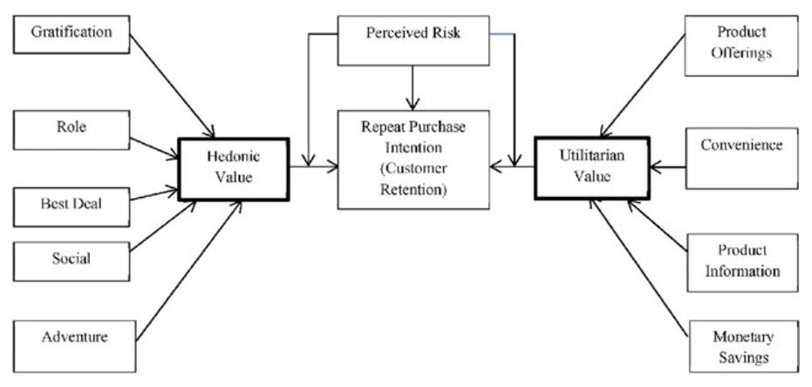
INTRODUCTION
E-retail factors for customer activation and retention: A case study from Indian e-commerce customers
Customer satisfaction has emerged as one of the most important factors that guarantee the success of online store; it has been posited as a key stimulant of purchase, repurchase intentions and customer loyalty. A comprehensive review of the literature, theories and models have been carried out to propose the models for customer activation and customer retention. Five major factors that contributed to the success of an e-commerce store have been identified as: service quality, system quality, information quality, trust and net benefit. The research furthermore investigated the factors that influence the online customers repeat purchase intention. The combination of both utilitarian value and hedonistic values are needed to affect the repeat purchase intention (loyalty) positively. The data is collected from the Indian online shoppers. Results indicate the e-retail success factors, which are very much critical for customer satisfaction.

Slide 3
PROBLEM STATEMENT
Today, with the increasing recognition of the importance of customer retention and loyalty, companies now understand the importance of service.
The idea is that to understand the needs of customers as well as the changes in their needs over the time.
If the companies want loyal customers, the customers must be satisfied. The company should know what customers want from them.
Companies must provide good services to attract more and more customers.
Ways to achieve combination of both utilitarian value and hedonistic values for repeat purchase intention.

Slide 4
EDA STEPS
We will start by importing the libraries that we require for performing EDA. These include NumPy, Pandas, Matplotlib, and Seaborn.
We will now read the data from a excel file into a Pandas DataFrame.
We will display top 5 rows by using .head() function to know if it has the right type to data in it or not.
Using .shape function to display total number of rows and columns present in the dataset.
Using .columns function to display all the columns name present in the dataset.
We will now check for missing values in our dataset. In case there are any missing entries, we will impute them with appropriate values (mode in case of categorical feature, and median or mean in case of numerical feature). We will use the isnull().sum() function for this purpose.
We will now check datatype of each columns by using .info() function.
We will now display number of unique values in each columns by using .nunique() function.
Use describe() function to get statistical details like count, percentiles, mean, std, and maximum value of a data frame.
Analyzing relationships between variables.

Slide 5
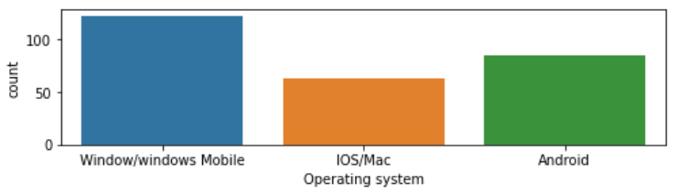
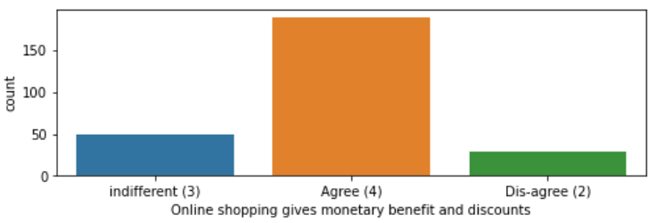
VISUALIZATIONS
Using countplot function from seaborn library to visualize columns which gives insights about the data.
Writing down inferences from each plot of univariate analysis.
It gives the rough idea about the data.

Slide 6
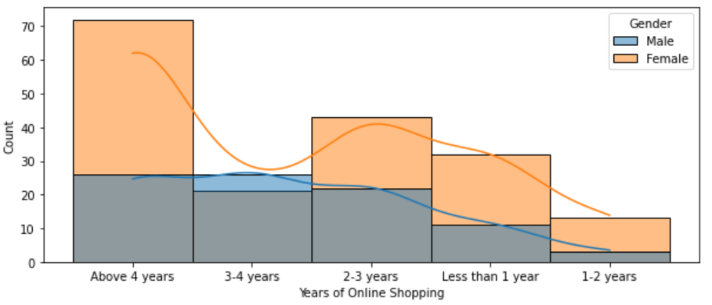
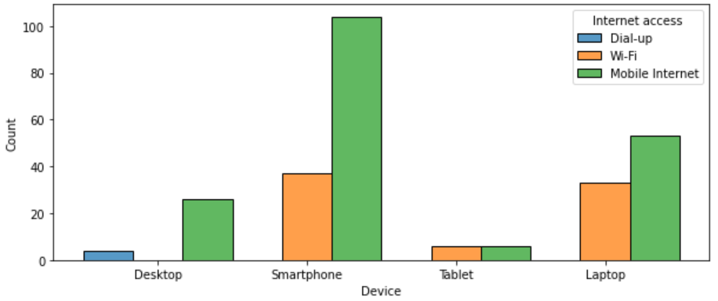
Using histplot function from seaborn library to visualize relationship between categorical variables.
Writing down inferences from each plot of bivariate analysis.
Using different parameters for better visualization of categorical variables.
Closely examining the plots and drawing conclusions out of it for business perspective.

Slide 7
STEPS AND ASSUMPTIONS
Renaming the columns as it was having lots of spaces in it and shortening the words for better view point.
Dropping unnecessary columns which is not useful for prediction.
Removing duplicate elements and appending into one as it had some how same meaning but was represented differently.
Ex- Strongly agree, Agree and Strongly dis-agree, Dis-agree etc.
Visualizing the data using seaborn and matplotlib.
Doing univariate and bivariate analysis for finding insights from data.
Applying label encoder function to convert categorical variables into integers for model building further.

Slide 8
ANALYSIS
Female customers are more likely to do online shopping.
Smartphone is used mostly for shopping online with lot of them using mobile internet for internet access.
Credit/Debit cards and CoD (cash on delivery) payment option has been used mostly by customers for shopping online.
Customers add and remove items from their shopping cart mostly if they find better alternative offer elsewhere.
Amazon & Flipkart has been well appreciated by customers in all aspects (security, privacy, trust, reliability etc)
Female customers takes more time exploring e-retail store than male before making a purchase decision.
Delhi city has the maximum count of customers doing online shopping.

Slide 9
CONCLUSION
Strong brand-customer relationships drives loyalty and repeat purchases.
Existing customer is five to six times more profitable than a new customer.
Product value is the primary driver for customer retention.
If you want to create an effective customer retention strategy, it starts with understanding what your customers value and providing a product that matches that.
Use data to understand your customers, their likes and dislikes, their shopping behavior patterns, etc and customize your services accordingly.
Be creative with the services you offer and go with the trend unless you come up with a brilliant marketing strategy.
The recipe for customer retention is simple – retail has to become relentlessly customer-focused.

Slide 10
THANK YOU !

